Slide 1
CS 4031 Compiler Construction Chapter 8 cont.
Faryal Saud
Lecturer, Department of Computer Science
FAST NUCES CFD

Slide 2
Logical Expression
An expression that contains operators like +, –, *, / are simple arithmetic expressions, whereas the expression that contains relational operators like , ≥, ≤, or , and, not, etc., are logical expressions.
The use of logical expression always results in either true or false, which is considered 0/1. 0 indicates false and 1 or a positive number indicates true.

Slide 3
Rules for Logical Expression
E → E1 or E2
E → E1 and E2
E → not E1
E → id1 relop id2
E → (E1 )
E → true
E → false

Slide 4
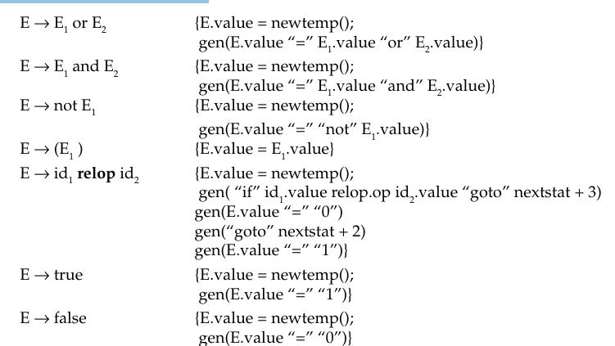
The translation rules to convert to three address code are as follows

Slide 5
Example:
Write three address statement and SDT for the x or y and not z.

Slide 6
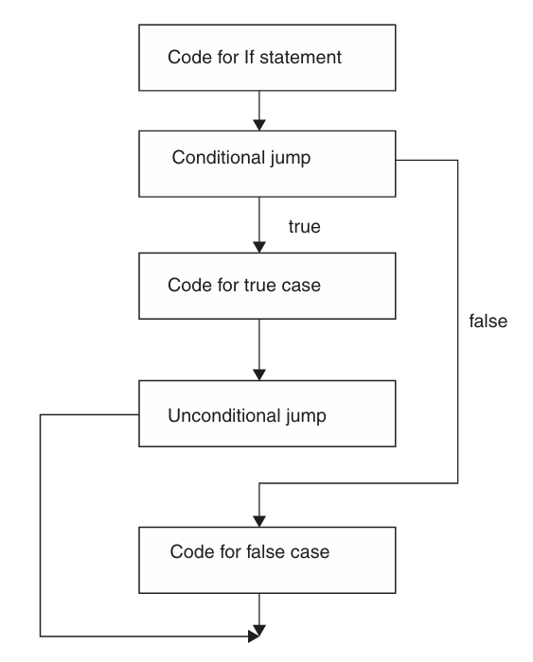
If Else Structure

Slide 7
The rules for writing different constructs are as follows:
S →. if E then S1
S → if E then S1 else S2
S → while E do S1

Slide 8
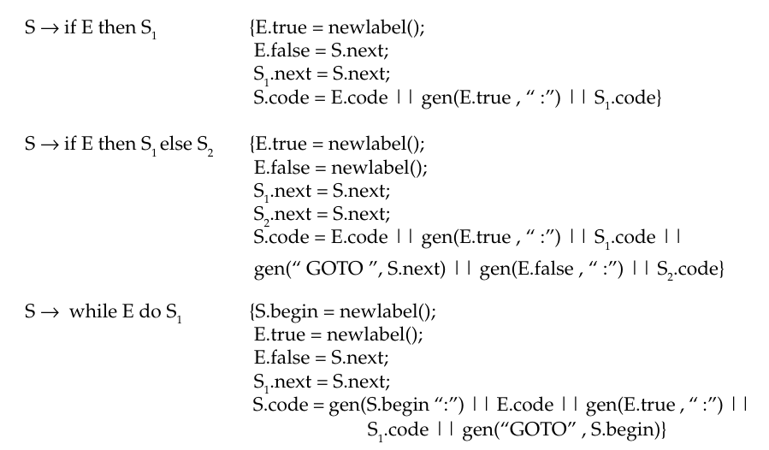
The translation rules are as follows:

Slide 9
Example:
Give three address code and Syntax Directed Translation for the following:
While (a < 5) do a: = b + 2

Slide 10
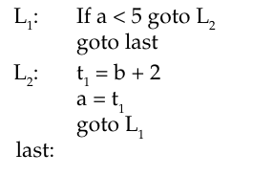
Solution:

Slide 11
Code Generation Process in LLVM
The frontend of LLVM outputs target independent LLVM IR code
Compiler Backend has to transform this into machine code for a specific platform
In this process it can apply optimizations for the targeted platform

Slide 12
Why we use LLVM
Modern Compiler (with an arguably modular design).
Language Agnostic.
Better documentation (compared to alternatives).
Less restrictive license.
Easier to extend, add optimizations, add new targets, etc.

Slide 13
Auto-Vectorization in LLVM
Converts code using only scalar data types and operations into code using vector-types and operations.
Vectorizing can lead to significant performance gains.
The compiler can perform vectorizing for the programmer (sometimes).

Slide 14
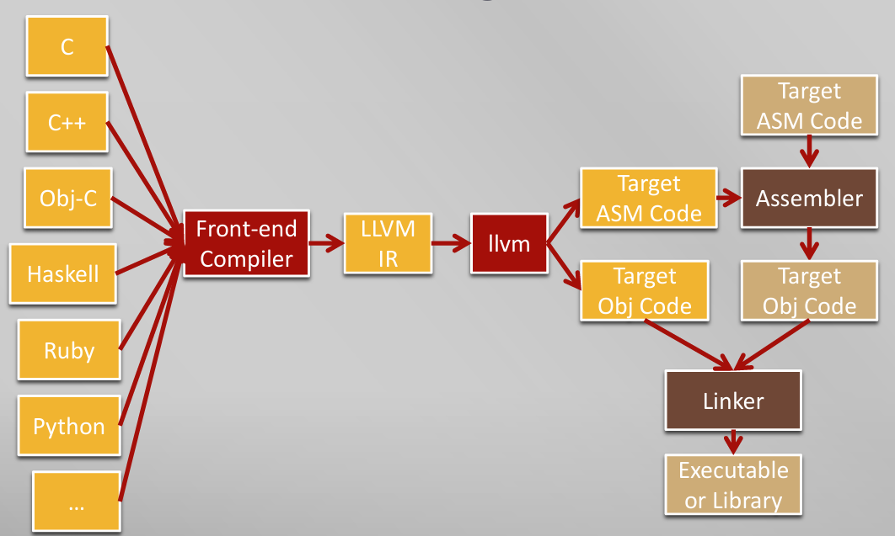
LLVM Tool chain for High Level

Slide 15
Main Task of LLVM
The main purpose of LLVM is to
Code Generation
Selection Phase
Scheduling and formation
Register allocation phase
Final phase
Auto Vectorization
Loop Vectorization

Slide 16
Code Generator
Code generation is one of the most complex tasks in the LLVM
We need to "lower" the LLVM IR into the corresponding machine code
Optimize code and replace unsupported data types and operations for the target platform
LLVM supports this process through it’s target-independent code generator framework

Slide 17
Processing Steps
Instruction Selection
Scheduling and Formation
SSA-based Machine Code Optimizations
Register Allocation
Prolog/Epilog Code Insertion
Final Optimizations
Code Emission

Slide 18
Key Features of TAC in LLVM
Each instruction has at most three operands (hence "three-address").
Example: a + b
Three address code : %t1 = add i32 %a, %b ; t1 = a + b
Uses SSA form, meaning each variable is assigned exactly once.
Operations are explicit, including arithmetic, memory access, and control flow.
Example: If(a<b) then s1
%cmp = icmp slt i32 %a, %b ; Compare: a < b
br i1 %cmp, label %if_true, label %if_false ; Branch based on comparison

Slide 19
LLVM Basics
A Static Single Assignment (SSA) based representation that provides type safety, low-level operations, flexibility, and the capability of representing 'all' high-level languages cleanly.
Contains many instructions normally found in target assemblies:
Binary operations:
ret, br, add, sub, mul, udiv, sdiv, urem, srem, fadd, fsub, fmul, fdiv.
Bitwise operations:
shl, lshr(logical), ashr (arithmetic), and, or, xor
Comparisons
icmp, fcmp (perhaps, ASMs don’t normally have this form).
Memory operations
load, store, cmpxchg

Slide 20
Binary Operation
Operation | Purpose
ret | Return from a function.
br | Branch to another instruction based on a condition.
add | Perform addition of two operands.
sub | Perform subtraction of two operands.
mul | Perform multiplication of two operands.
udiv | Perform unsigned division of two operands.
sdiv | Perform signed division of two operands.
urem | Compute the remainder of unsigned division.
srem | Compute the remainder of signed division.
fadd | Perform floating-point addition.
fsub | Perform floating-point subtraction.
fmul | Perform floating-point multiplication.
fdiv | Perform floating-point division.

Slide 21
Example:
Let’s consider a simple C function:
int foo(int aa , int bb, int cc)
{
int sum = aa + bb;
return sum / cc;
}

Slide 22
Convert into Three Address Code
define i32 @foo(i32 %aa , i32 %bb, i32 %cc)
{
entry :
%add = add i32 %aa, %bb
%div = sdiv i32 %add, %cc
ret i32 %div
}

Slide 23
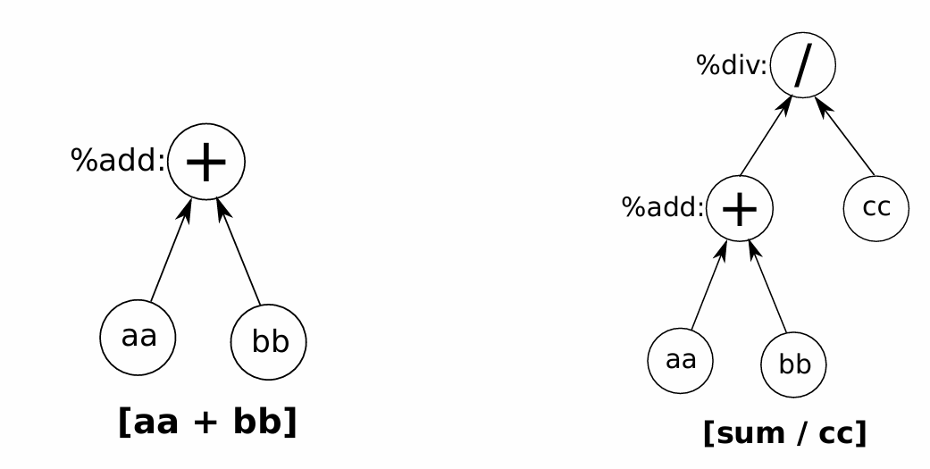
DAG

Slide 24
Example:
Let Consider the Simple C Code
int main() {
int a = 10, b = 4, result;
result = a + b;
result = a - b;
result = a * b;
result = a / b;
result = a % b;
return 0;
}

Slide 25
LLVM Code : Declaration
$1 | INT
$2 | ID → the variable name like a
$3 | ASSIGN
$4 | expr → the evaluated integer like 10
$5 | SEMICOLON
int a = 10, b = 4, result;
Code:
declaration:
INT ID ASSIGN expr SEMICOLON {
printf("@%s = global i32 %d\n", $2, $4);
}

Slide 26
Declaration Example
Detail of Three Address Code
Printf | prints the declaration as LLVM IR code.
@%s | refers to the variable name (LLVM global variable syntax)
global i32 %d | declares it as a global 32-bit integer with an initial value.
$2 | ID → the variable name like a
$4 | expr → the evaluated integer like 10

Slide 27
Expression: Plus
expr PLUS expr {
int reg = get_new_reg();
printf(" %%r%d = add i32 %d, %d\n", reg, $1, $3);
$$ = reg;
}
Function for Register
int reg_count = 0;
int get_new_reg() {
return reg_count++;
}
$$ = reg;
Used to store the result of register

Slide 28
Explanation:
int reg = get_new_reg();
gets a new register number for the result of the addition.
2. printf(" %%r%d = add i32 %d, %d\n", reg, $1, $3);
Used for the output statement
%r<reg> = add i32 <left operand>, <right operand>
reg is the result register.
$1 is the left-hand side value (expr).
$3 is the right-hand side value (expr).

Slide 29
Complete code for Arithmetic Expression
expr:
expr PLUS expr {
int reg = get_new_reg();
printf(" %%r%d = add i32 %d, %d\n", reg, $1, $3);
$$ = reg;
}
| expr MINUS expr {
int reg = get_new_reg();
printf(" %%r%d = sub i32 %d, %d\n", reg, $1, $3);
$$ = reg;
}
;

Slide 30
Complete code for Arithmetic Expression
| expr MUL expr {
int reg = get_new_reg();
printf(" %%r%d = mul i32 %d, %d\n", reg, $1, $3);
$$ = reg;
}
| expr DIV expr {
int reg = get_new_reg();
printf(" %%r%d = sdiv i32 %d, %d\n", reg, $1, $3);
$$ = reg;
}
| expr MOD expr {
int reg = get_new_reg();
printf(" %%r%d = srem i32 %d, %d\n", reg, $1, $3);
$$ = reg;
}
| NUMBER { $$ = $1; }

Slide 31
Running Procedure
bison -d parser.y
flex scanner.l
gcc parser.tab.c lex.yy.c -o compiler -lfl
./compiler < test.c

Slide 32
LLVM in User Code Section
int main() {
ir_file = fopen("output.ll", "w");
printf(ir_file, "define i32 @main() {\n");
yyparse();
fclose(ir_file);

Slide 33
Running Procedure for LLVM
clang output.ll -o program

Slide 34
Sample output of LLVM
@a = global i32 10
@b = global i32 4
@res = global i32 0
%r0 = add i32 10, 4
store i32 %r0, i32* @res
%r1 = sub i32 10, 4
store i32 %r1, i32* @res
%r2 = mul i32 10, 4
store i32 %r2, i32* @res
%r3 = sdiv i32 10, 4
store i32 %r3, i32* @res
%r4 = srem i32 10, 4
store i32 %r4, i32* @res

